Slide 1



TICKET SYS PLATFORM
Shubham Jain(21CS8130)
Arnab Nath(21CS8131)
Swagata Sinha(21CS8132)
Praneeth Mareddy(21CS8133)
Divyansh Gupta(21CS8134)
Rohan Agarwal(21CS8135)
Ashutosh Kumar(21CS8136)
Shubhodaya Sarkar(21CS8137)
Pankhuri Kumari(21CS8138)

Slide 2


PROBLEM DESCRIPTION
Develop a TicketMaster as a leading ticketing platform where event-executors can sell tickets for concerts, theaters, and sporting events and audience/users can purchase tickets
Probable Features of the system:
Visual map of available spots, marking it as "reserved" until payment completion
Define allocation policy
Display various deals and packages
Dynamic pricing (price reduction/escalation for last minute bookings; seat position, etc.) system
Text-based user interface & availability matrix visualization & ticket generation
The system satisfy the following requirements:
Enables event managers & users to login from different terminals from different physical machines
Enables Manager/User registration and authentication (using some hash based password)
A user-friendly text interface
A multithreaded platform
Provide a well documented header file with set of well defined APIs/function interface so that any other
reservation scenario may be implemented with minor modification

Slide 3
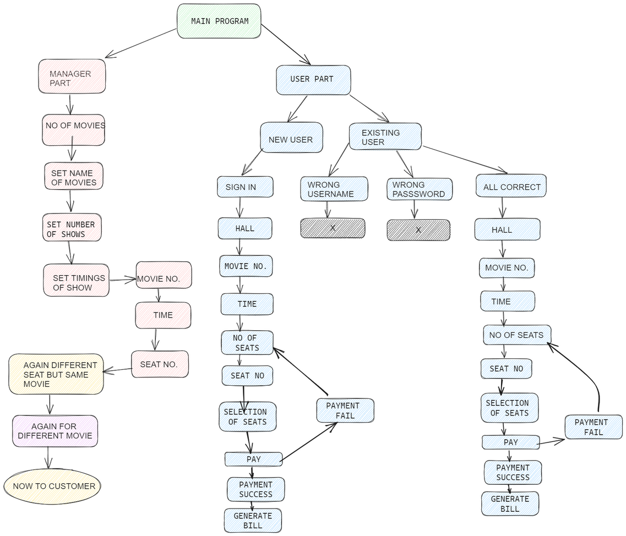
PROBLEM DESCRIPTION

Slide 4


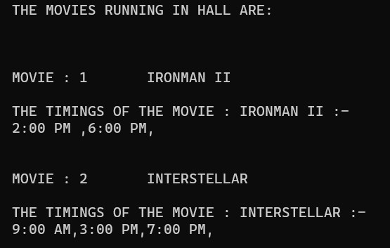
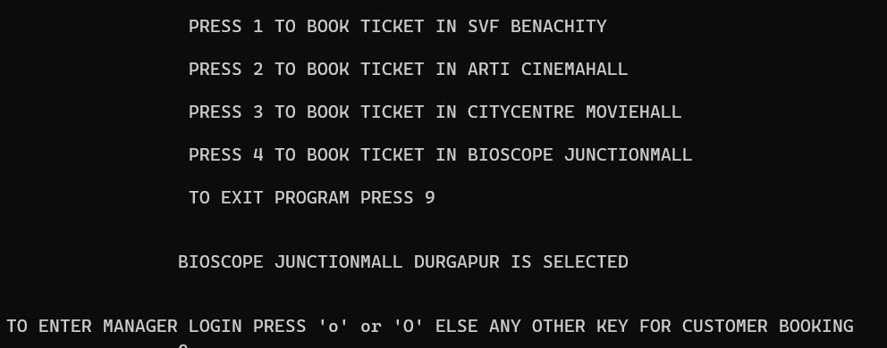
User Interface
A user-friendly interface with 4 cinema halls, accessible for managers (press 'O') and users (press any other key) to select movies and showtimes. Managers use 'O' key to control movie schedules, while users can navigate effortlessly for their movie choices.

Slide 5
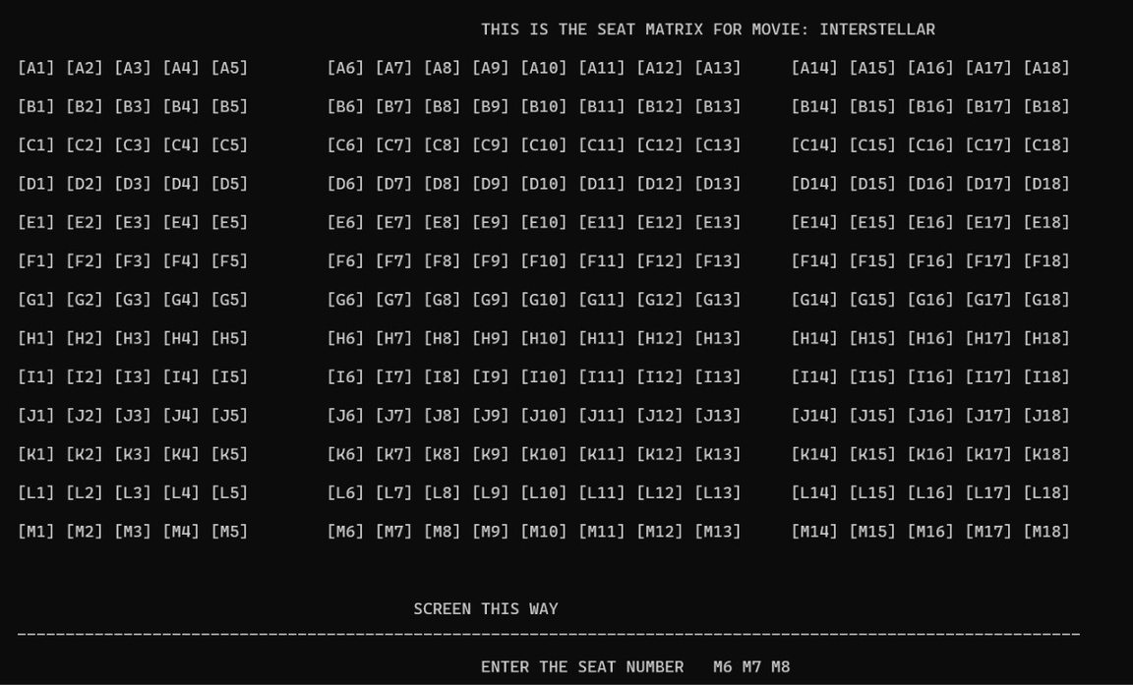
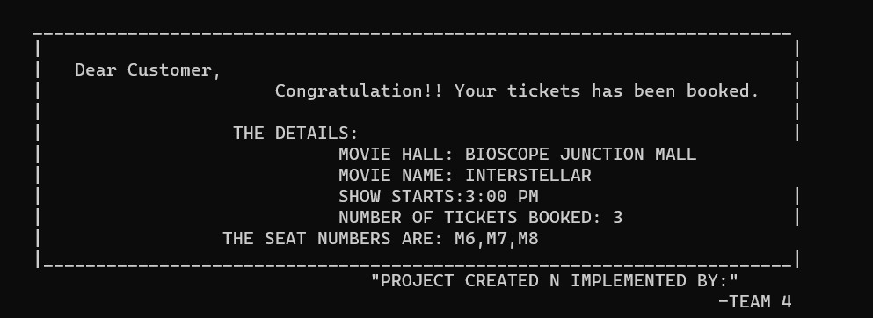
User Interface
Users easily view and select seats within the terminal's interactive seat matrix, streamlining the booking process. Once the payment is completed user receive a generated bill, all within the intuitive terminal interface for an efficient cinema booking experience.

Slide 6
APPLICATION LEVEL FEATURES
User Login: Allows users to create accounts or log in to access personalized features, such as booking tickets and get information about the show time, show name and already booked seats.
Manager Login: Provides access for cinema managers to manage movie schedules, pricing, and seat availability and number of shows per day.
Booking Tickets: Enables users to select a movie, showtime, and seats, and complete the ticket booking process securely.
Dynamic Pricing: Implements a pricing algorithm that adjusts ticket prices based on factors like time and seat availability, thus optimizing revenue for the cinema.
Movie Details: Displays information about multiple movies, including showtimes and price helping users make informed choices.
Seat Matrix: Offers an interactive seat map for users to visualize and select available seats, enhancing the booking experience and avoiding double bookings.
Check Availability: Allows users to check seat availability for specific shows, helping them plan their cinema visit in advance.

Slide 7
CONTRBUTION
MANAGER SIDE: Swagata Sinha, Arnab Nath, Ashutosh Kumar
Authorization of manager, adding movies, movie timing, pricing and marking seats as selected.
CUSTOMER SIDE: Rohan Agarwal, Shubham Jain, Divyansh Gupta
Registration of new customers, authorization of existing customers, and seat booking by customers by choosing movie names and timings of the show.
USER INTERFACE: Shubhodaya Sarkar, Praneeth Mareddy, Pankhuri Kumari
Design and updation of the seat matrix for each movie and their corresponding timing, generation of billing slips.

Slide 8
THANK YOU

